Slide 1
Blinkit Grocery Analysis – Power BI Dashboard
Sales, Ratings & Inventory Insights for Smarter Decisions

Slide 2
Project Objective
1
Objective:
To conduct a comprehensive analysis of BlinkIT’s grocery performance, including sales, customer satisfaction, and inventory trends. This project uses Power BI to uncover actionable insights through interactive visualizations and well-defined KPIs.

Slide 3
Business Problem
Business Challenges Identified:
Inconsistent insight on outlet performance
based on size, type, and location
Lack of visibility into which
product types perform best
Need to correlate inventory items
with customer satisfaction
No clear understanding of
how fat content affects sales
Absence of a centralized system to view KPIs like average sales and ratings

Slide 4
Proposed Solution
Solution Strategy:
Build DAX measures for dynamic KPI calculations
Visualize relationships between sales, outlet types,
and inventory
Import, clean, and process data from BlinkIT database
Develop an interactive Power BI dashboard with
slicers and filters
Summarize actionable insights to guide strategic decisions

Slide 5
Project Lifecycle Steps
Requirement Gathering – Understanding Blinkit’s goals
📊 Data Walkthrough:
Exploring raw sales and inventory files
🧹 Data Cleaning:
🔌 Data Connection:
Power BI data integration
Checking for missing values and duplicates
🧠 Data Modeling:
Defining relationships between tables
⚙Data Processing:
Applying transformations

Slide 6
Project Lifecycle Steps
Requirement Gathering – Understanding Blinkit’s goals
➕ DAX Calculations:
Creating KPIs: AVG SALES, TOTAL SALES, etc.
🖼 Dashboard Layout:
📈 Chart Development:
Using funnel, bar, doughnut, and matrix visuals
Designing clean layout with slicers
🧩 Report Building:
🔍 Insight Generation:
Integrating filters and interactive views
Deriving trends and strategies

Slide 7
KPI Metrics Defined
KPI Description:
Total Sales
Number of Items
Total revenue generated from all items sold
Total count of different SKUs sold
Average Sales
Average Rating
Average revenue per sale
Average customer satisfaction per item

Slide 8
Total Sales by Fat Content
Insights:
Objective:
Regular and Low Fat have nearly equal contributions (~50%)
Suggests balanced consumer preference for fat content
Helps determine product development focus
To analyze the impact of fat content on total sales.
Chart Type:
Doughnut Chart

Slide 9
Average Sales by Item Type
Objective: To identify which product types generate the highest average sales.
Chart Type: Horizontal Bar Chart
Insights:
Dairy, Household, and Snack Foods top the list
Baked Goods and Health items show lower avg sales
Useful for inventory optimization and promotions

Slide 10
Fat Content by Outlet
Insights:
Objective:
All outlet types show balanced performance
Slight variations in fat preferences across locations
Can be leveraged for personalized regional stocking
To compare total sales across outlets, segmented by fat content.
Chart Type:
Stacked Column Chart

Slide 11
Total Sales by Outlet Establishment Year
Objective:
Chart Type:
Insights:
To evaluate how the year of establishment affects sales growth.
Line/Waterfall Chart
Outlets established in 2017 onward show rapid growth
Total sales have increased consistently with new outlets
Highlights the importance of expanding modern stores

Slide 12
Sales by Outlet Size
Objective:
To analyze how outlet size influences sales figures.
Chart Type:
Pie/Doughnut Chart
Insights:
Tier 2 contributes the most (369.28K), followed by Tier 3
Smaller Tier 1 outlets generate the least
Suggests better performance from mid-sized outlets

Slide 13
Sales by Outlet Location
Objective:
To study geographic sales distribution across outlet tiers.
Chart Type:
Funnel Chart
Insights:
Sales funnel shows Tier 2 at the top, Tier 1 at the bottom
Opportunity to improve visibility in Tier 1 regions
Could drive marketing strategies by tier-wise sales

Slide 14
All Metrics by Outlet Type
Grocery Store: ₹74,251.71 total sales, avg sales ₹141.16, 526 items, avg rating 3.93, visibility 56.31.
Supermarket Type 1: ₹7,39,886.89 total sales, avg sales ₹139.92, 5235 items, avg rating 3.92, visibility 338.65.
Supermarket Type 2: ₹1,22,388.20 total sales, avg sales ₹142.08, 863 items, avg rating 3.93, visibility 56.62.
Total: ₹9,36,526.79 total sales, avg sales ₹141.38, 6624 items, avg rating 3.92, visibility 451.58.
Insights:
Objective:
To provide a consolidated view of key metrics per outlet type.
Key Insights & Observations
Chart Type:
Matrix Card Table

Slide 15
Key Insights & Observations
Balanced sales between low
and regular fat products
Tier 2 locations dominate overall sales
Dairy and snack food categories
are high performers
Supermarket Type 1 stores handle the
highest volume and visibility
Outlet establishment year strongly
influences sales volume
Item visibility metrics reveal opportunities
for shelf optimization

Slide 16
Conclusion
✅ BlinkIT shows a well-balanced inventory-to-sales ratio
✅ Regional outlet strategy is yielding visible performance gains
✅ KPI-based approach provides clarity in inventory and marketing
✅ Power BI dashboard offers a dynamic and decision-support system
✅ Recommended to focus on high-performing categories and Tier 2 expansion

Slide 17
Final Dashboard Snapshot
Title:
Visuals:
Blinkit Power BI Dashboard
Doughnut, Funnel, Bar, Matrix, Waterfall
Insights into fat content, outlet tiers, product types
Features:
Interactive filters (outlet location, size, item type)
KPI cards for quick overview

Slide 18
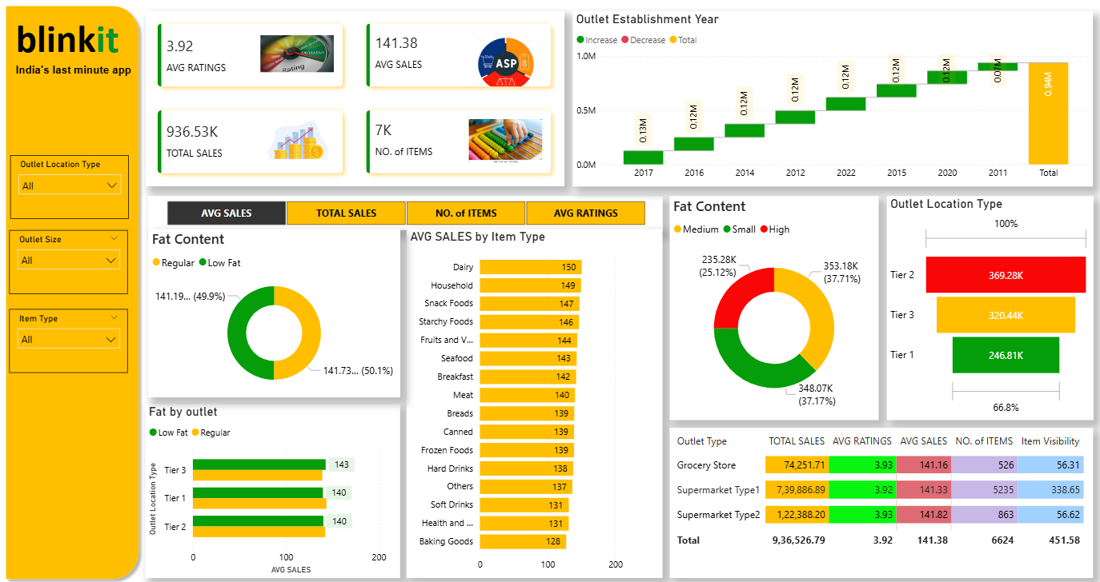

Slide 19
Thank You
2
Thank you for your attention!
For feedback, improvements, or project collaboration:

